Slide 1
Translating restoration priorities
into projects
John Green, Lead Scientist
Gold Ridge Resource Conservation District
www.goldridgercd.org
February 2016

Slide 2
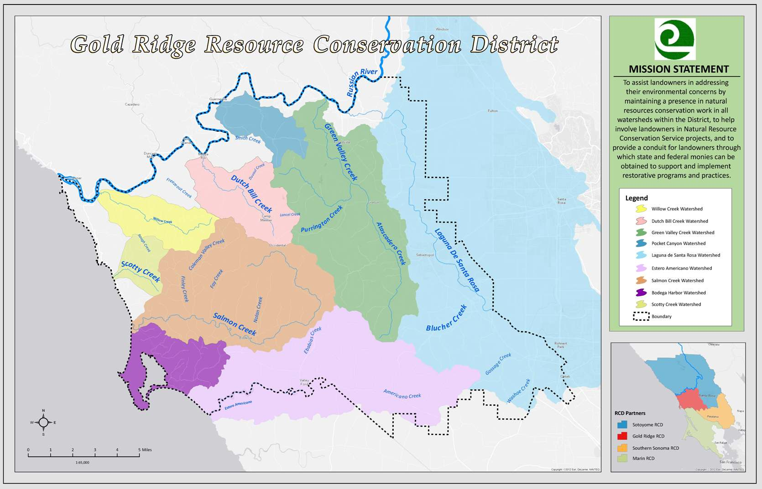
Notes:
Emphasize habitat watersheds

Slide 3
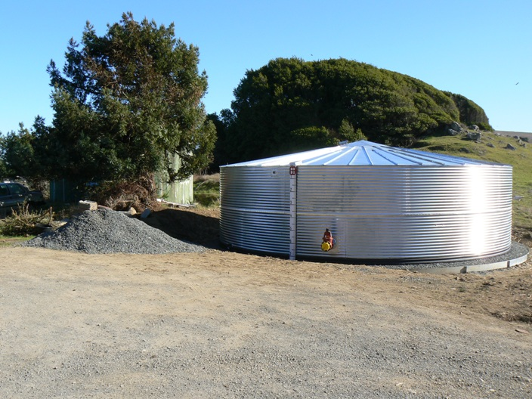
GRRCD water conservation projects
Notes:
Things we’ve been doing for a long time. Effective at improving habitat conditions.
3

Slide 4
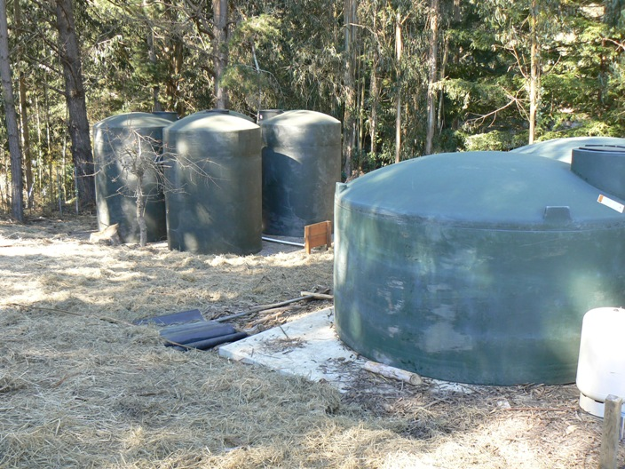
GRRCD water conservation projects
Multiple benefits
Notes:
Things we’ve been doing for a long time. Effective at improving habitat conditions.
4

Slide 5
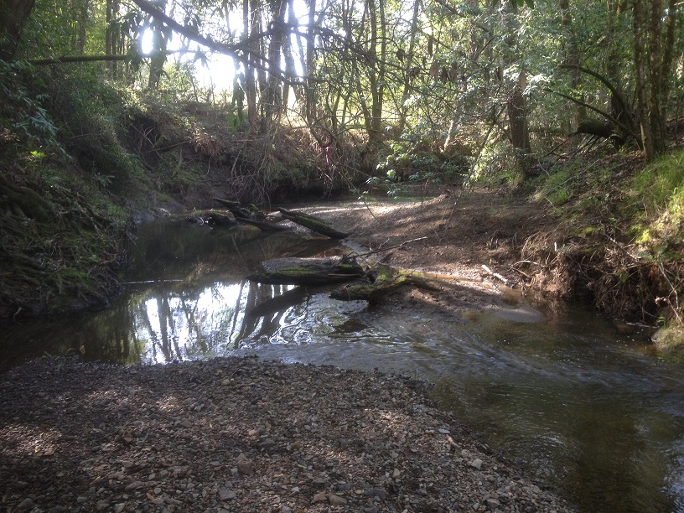
GRRCD water conservation projects
Multiple benefits
  Instream flow
Notes:
Things we’ve been doing for a long time. Effective at improving habitat conditions.
5

Slide 6
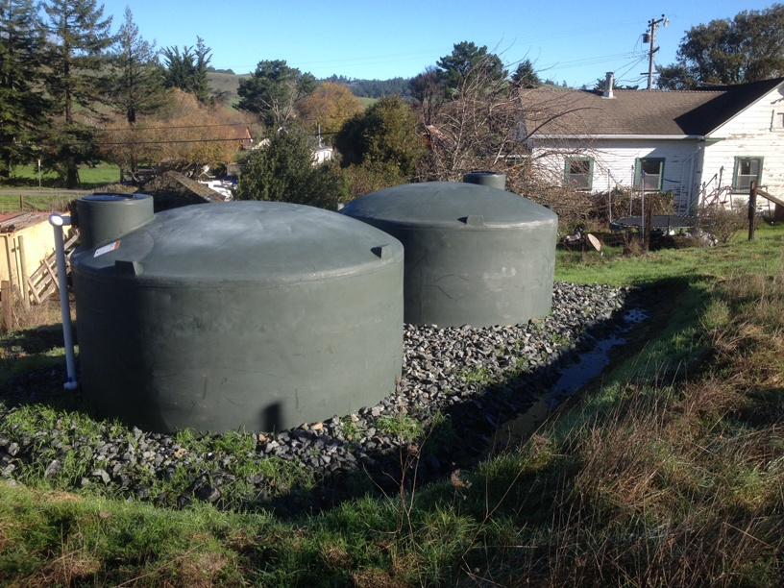
GRRCD water conservation projects
Multiple benefits
  Instream flow
  Water supply security
Notes:
Things we’ve been doing for a long time. Effective at improving habitat conditions.
6

Slide 7
GRRCD water conservation projects
Multiple benefits
  Instream flow
  Water supply security
  Flexibility
Notes:
Things we’ve been doing for a long time. Effective at improving habitat conditions.
7

Slide 8
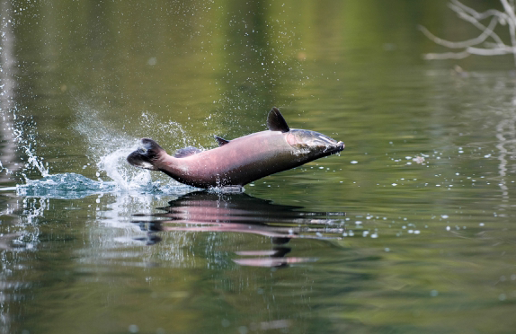
Coho restoration strategies
Notes:
Recap of history and evolution of restoration,
8

Slide 9
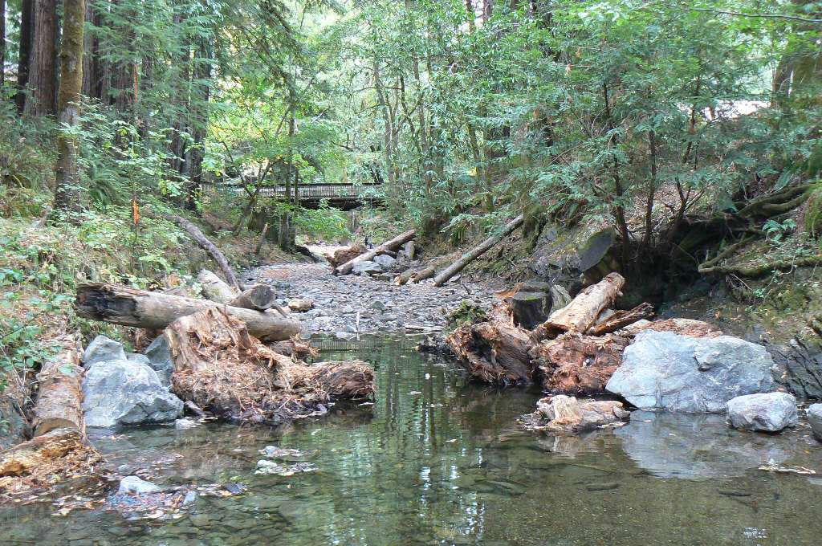
Coho restoration strategies
Instream habitat
  Channel complexity
  Habitat indicators
Notes:
Things we’ve been doing for a long time. Effective at improving habitat conditions.
9

Slide 10
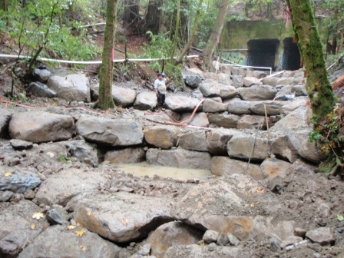
Coho restoration strategies
Instream habitat
  Channel complexity
  Habitat indicators
  Access to habitat
    Fish passage barrier removal
Notes:
10

Slide 11
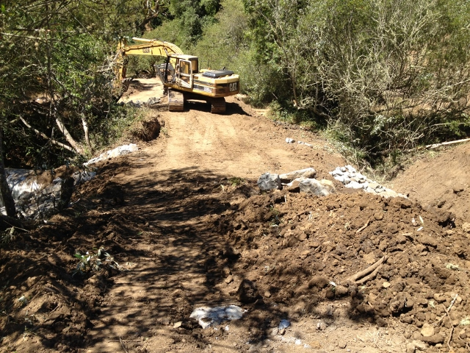
Coho restoration strategies
  Water quality
    Temperature
    Sediment
Notes:
11

Slide 12
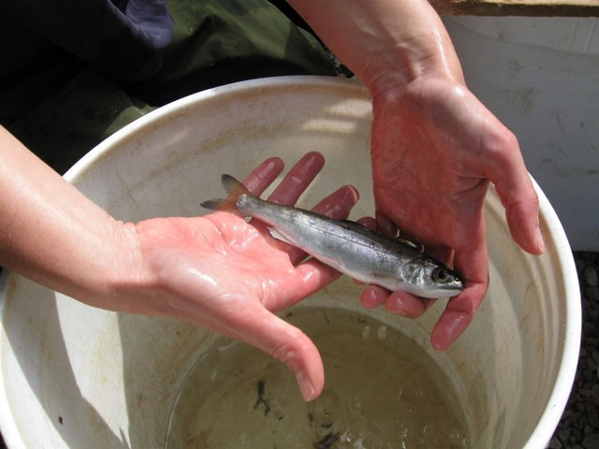
Coho restoration strategies
  Water quality
    Temperature
    Sediment
    Population augmentation
    Captive broodstock
Notes:
12

Slide 13
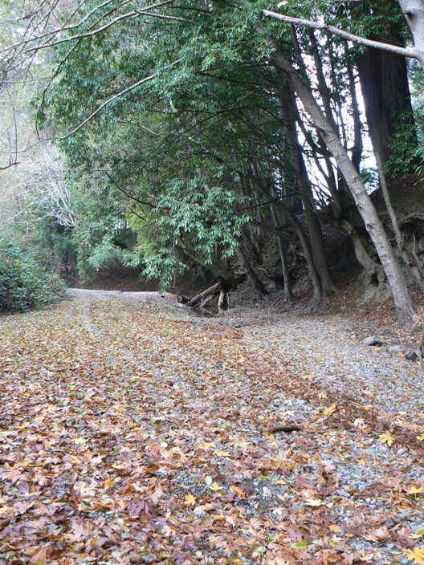
Coho restoration strategies
  None of these efforts will succeed if there is no water in the stream.
Notes:
13

Slide 14
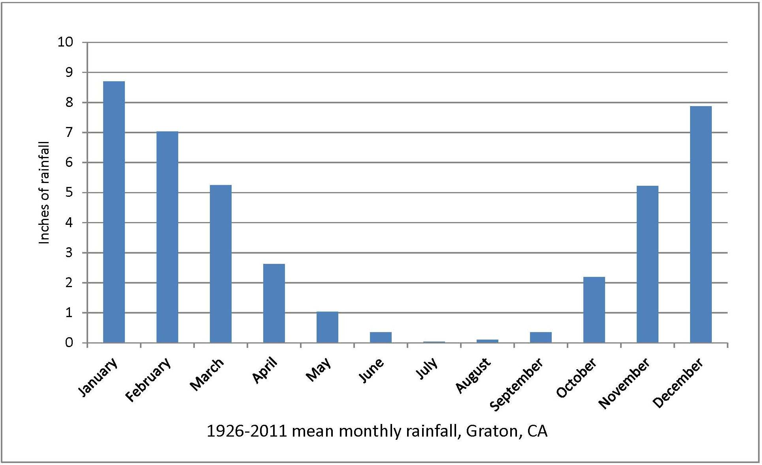
Northern California climate
Notes:
The underlying circumstance of low streamflow: seasonal drought. But coho evolved with these conditions.

Slide 15
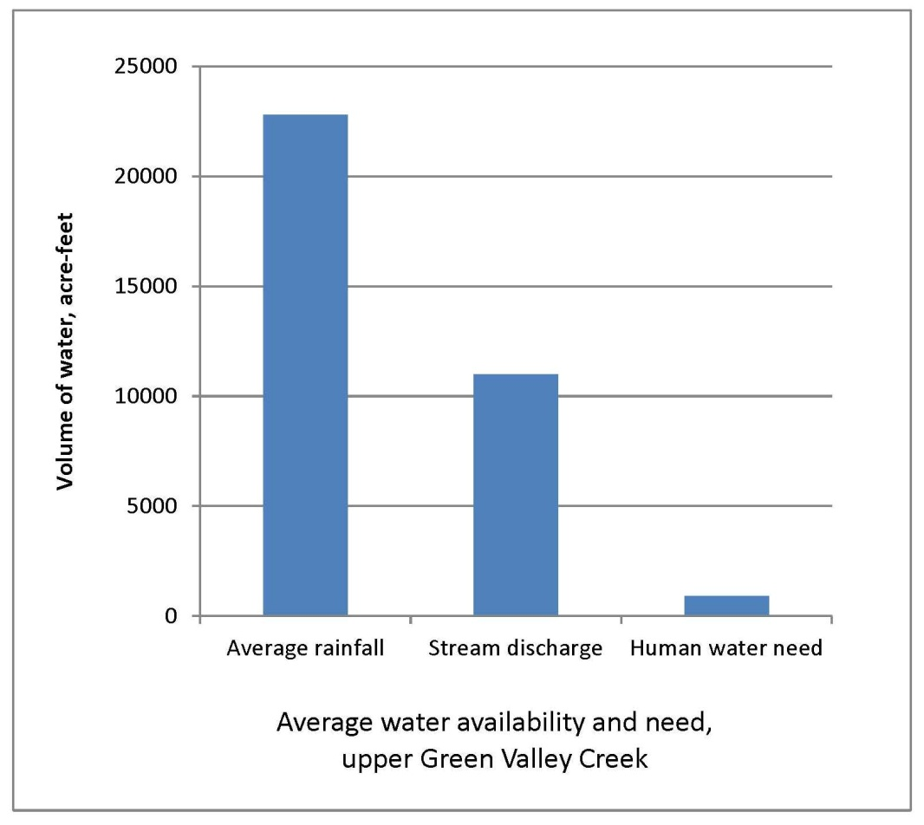
Improving streamflow
Notes:
Relatively straightforward premise to streamflow improvement work: timing of demand coincides with low flow. So shift the timing to a time of high flow – build water storage.

Slide 16
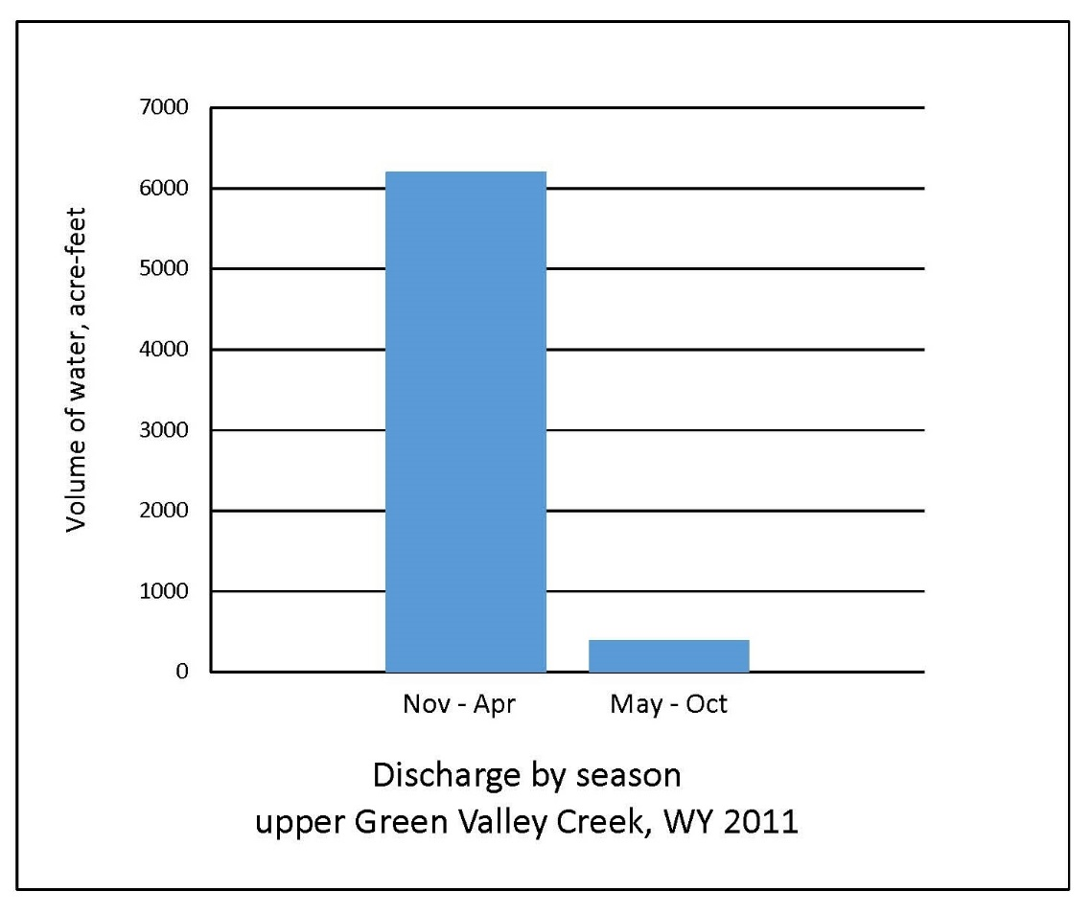
Notes:
You can see that over 90% of the total discharge flows downstream during the rainy season. So to address the streamflow part of the calculation, we need to change these proportions.

Slide 17
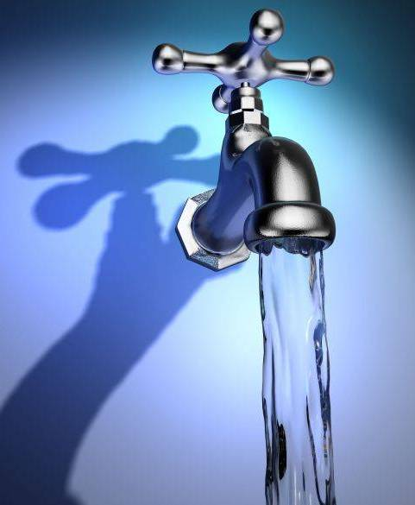
Coho restoration strategies
    Streamflow improvement
      To date, efforts have mostly focused on human water use
Notes:
Work on improving streamflow has been going on for less than a decade, after the realization that habitat work is not sufficient if there is no water. Focus has been on reducing the human water demand in hopes that a little extra water in the stream and in the ground will make the difference.
17

Slide 18
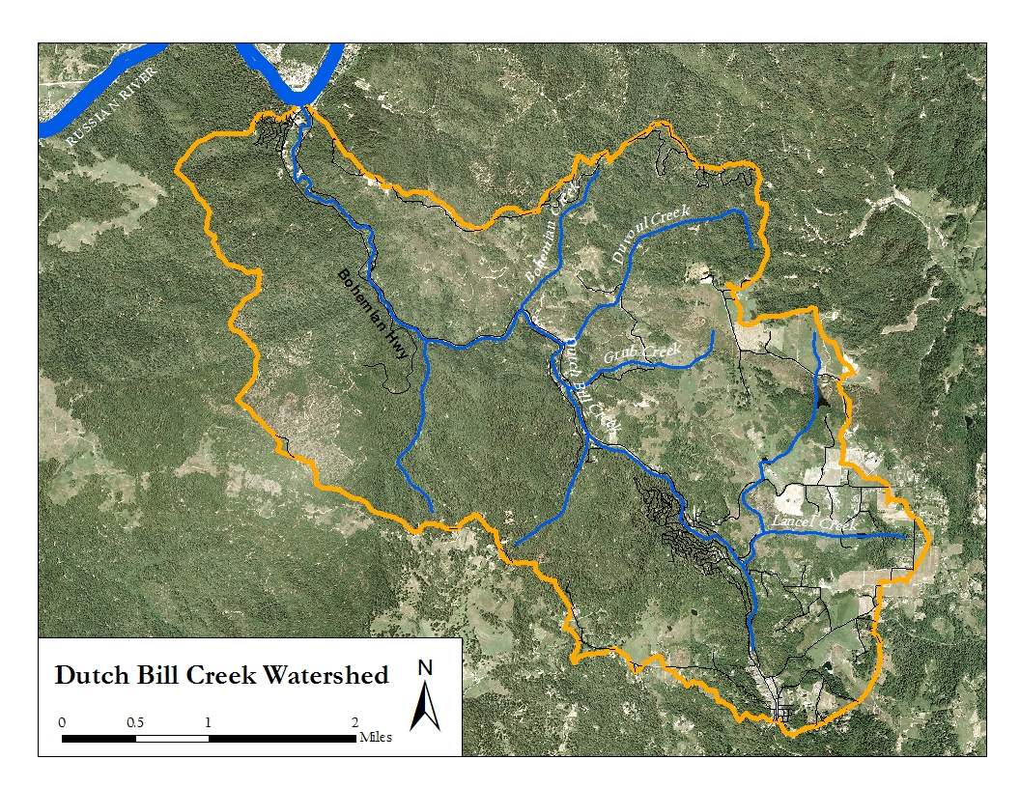
Notes:
Off-channel storage.
18

Slide 19
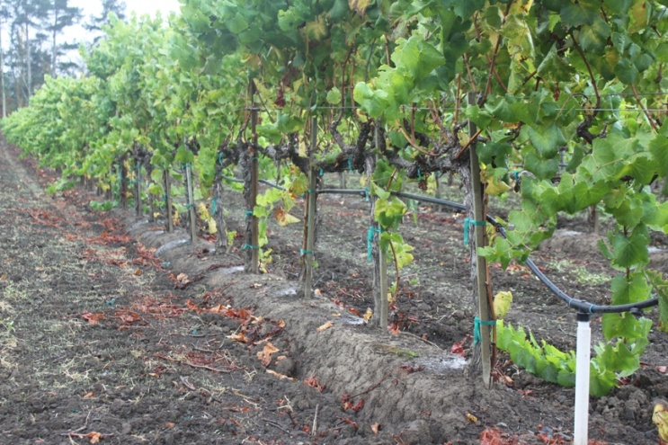
Improving streamflow
    Water conservation
Notes:
Off-channel storage.
19

Slide 20
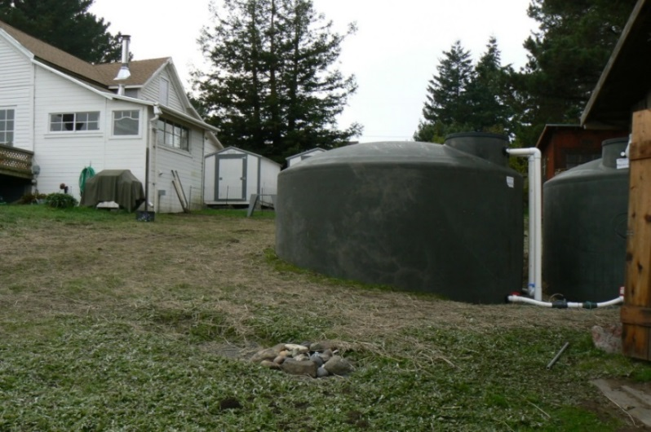
Improving streamflow
    Water conservation
    Alternative sources
Notes:
Off-channel storage.
20

Slide 21
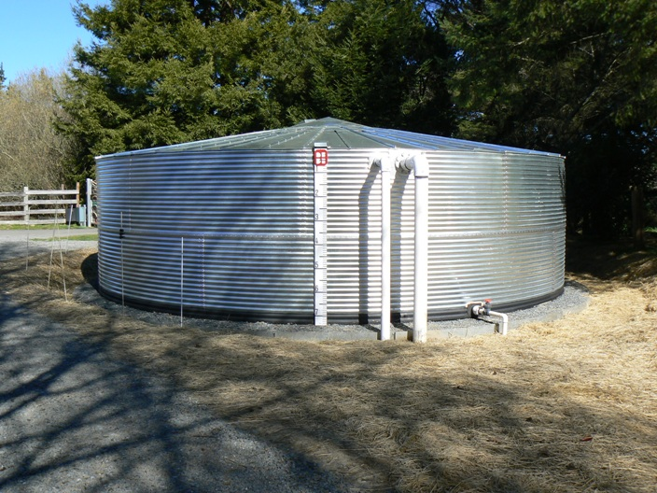
Improving streamflow
    Water conservation
    Alternative sources
    Off-channel storage
Notes:
Off-channel storage.
21

Slide 22
Improving streamflow
    Water conservation
    Alternative sources
    Off-channel storage
    Water release from reservoirs and other sources
Notes:
Off-channel storage.
22

Slide 23
Improving streamflow
    Water conservation
    Alternative sources
    Off-channel storage
    Water release from reservoirs and other sources
    Groundwater projects
Notes:
Off-channel storage.
23

Slide 24
Improving streamflow
    Efforts need to be targeted to reaches where they will make the most difference
Notes:
Off-channel storage.
24

Slide 25
Improving streamflow
    Russian River Coho Partnership
    Assisting landowners in designing and building water conservation, storage, and alternative source projects.
    Direct diversions
    Near-stream wells
Notes:
Off-channel storage.
25

Slide 26
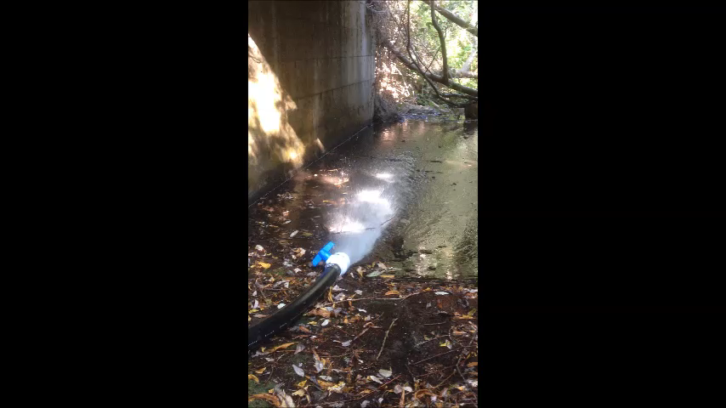
Notes:
26

